Slide 1
Simple Touch Prediction With Built-In IMUs Intermediate Presentation
Felix Bühler, Benedict Steuerlein
FaPra Machine Learning and Computer Vision for HCI | Pfaffenwaldring 5a | 22.01.19
Notes:
We are F and B an our subject is Simple Touch Prediction with built in IMUs

Slide 2
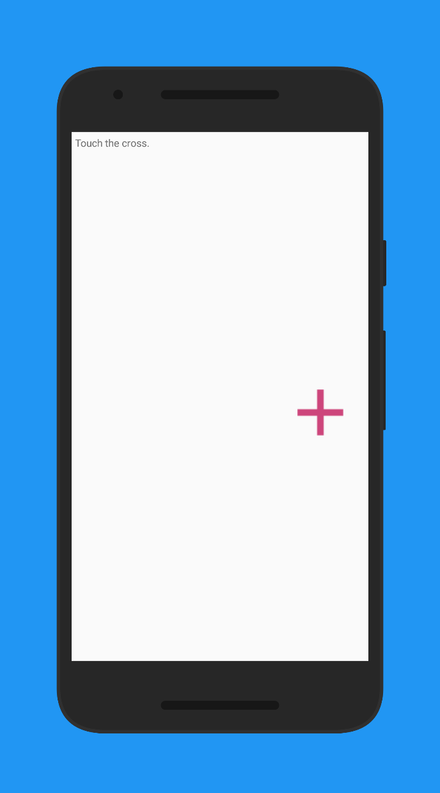
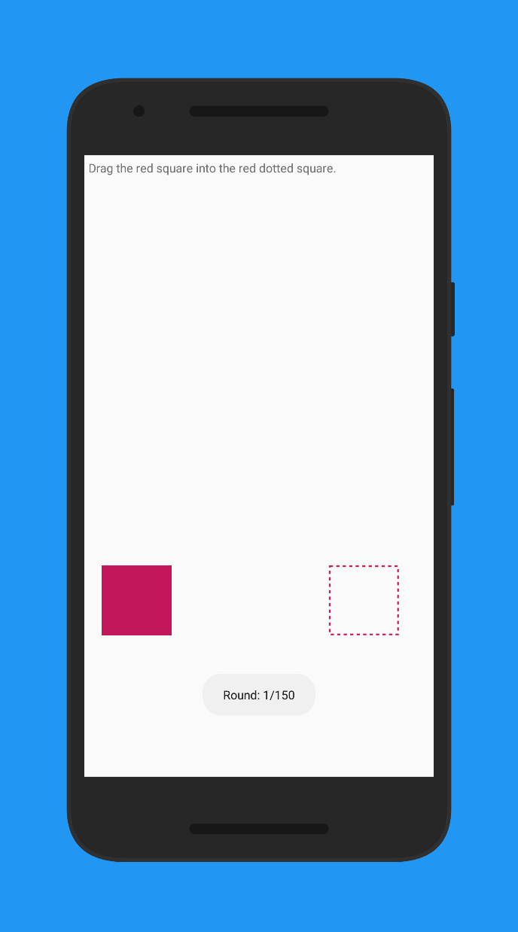
Finished our data collection study
Now we are training models
Current Status

Slide 3
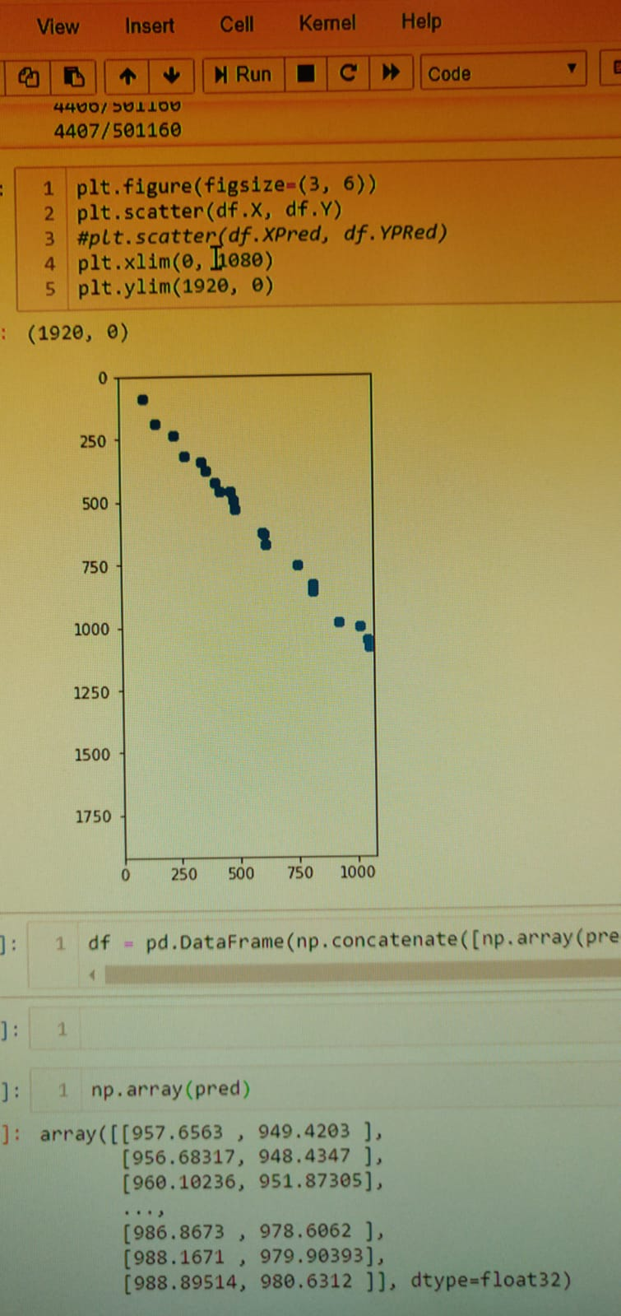
Preprocessing
Segmentation
Remove duplicates
Sensor data alignment
Data generator
Model training
Our Failure
For the touch task we tracked:
Time of touch
X coordinate of cross
Y coordinate of cross
X coordinate of actual touch
Y coordinate of actual touch

Slide 4
Preprocessing
Segmentation
Remove duplicates
Sensor data alignment
Data generator
Model training
Our Failure
For the touch task we tracked:
Time of touch
X coordinate of cross
Y coordinate of cross
X coordinate of actual touch
Y coordinate of touch

Slide 5
Preprocessing
Segmentation
Remove duplicates
Sensor data alignment
Data generator
Model training
Current Status
3 types of plots for our most promissing models:
Predicition plots
Show prediction and actual touches
And their relation
Origin plots
Move actual touches to origin
Move respective predicitions in the same order
Acc / Val_Acc plots
Acc and Val_Acc over time (epochs)

Slide 6
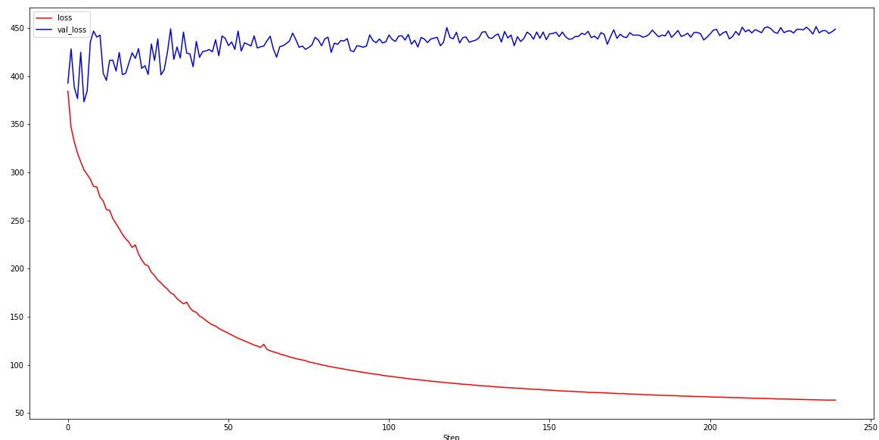
Model Accuracy
Pixel
This can’t be right
Epochs

Slide 7
Model Plots

Slide 8
Model Plots

Slide 9
Model Plots

Slide 10
Model Plots

Slide 11
Model Plots

Slide 12
Model Plots

Slide 13
Model Plots

Slide 14
Model Plots

Slide 15
Agenda
Nov
Dez
Jan 2019
Feb
Today
Discussion
11/6/2018
11/13/2018
2018
11/13/2018
Android App
11/27/2018
Data Collection Study
11/28/2018
12/11/2018
8 Tage
12/11/2018
Network Training
1/8/2019
Discussion
15 Tage
1/8/2019
1/15/2019
14 Tage
1/15/2019
Evaluation
1/29/2019
Paper Revision
29 Tage
1/29/2019
2/5/2019
8 Tage
11/27/2018
Writing Paper
2/5/2019
15 Tage
8 Tage
71 Tage
Notes:
Right no we are on schedule.
Finished implementing the study app.
From now on, we want to conduct the study

Slide 16
We are trying to improve our results.
We are going to reduce our features.
Only using dense layers isn‘t really a fancy approach. Is this this still OK?
Questions

